Slide 1
Searching

Slide 2
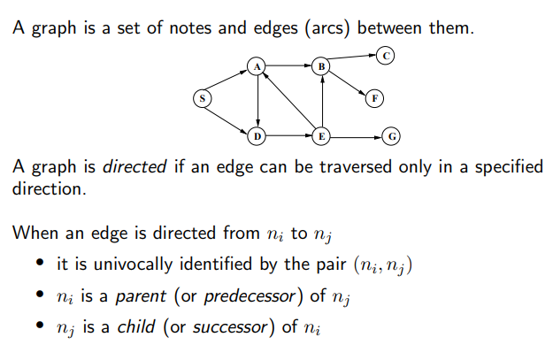
Graphs

Slide 3
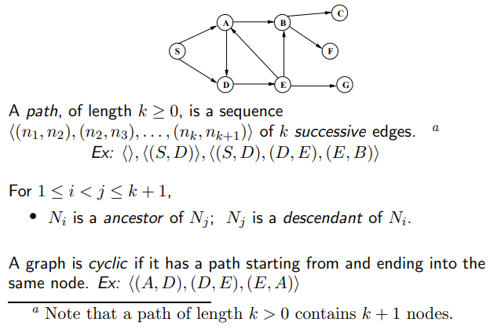
Directed Graphs

Slide 4
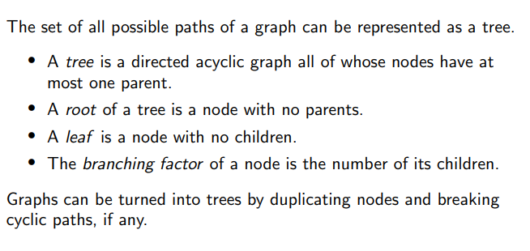
From Search Graphs to Search Trees

Slide 5
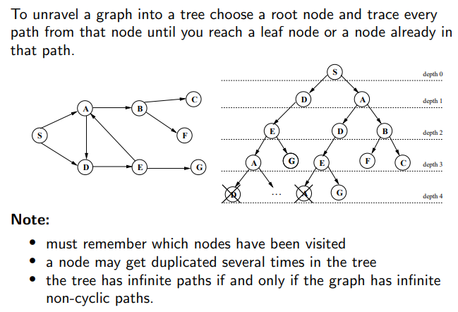
From Graphs to Trees

Slide 6
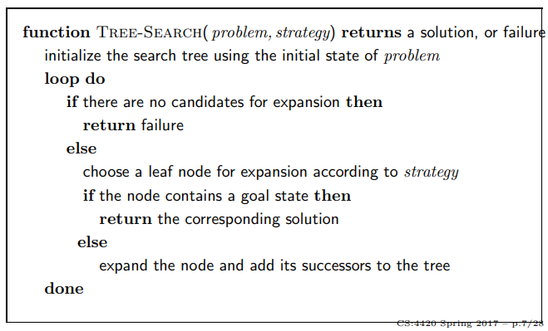
Tree Search Algorithms

Slide 7
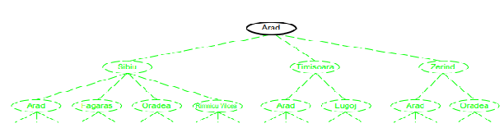
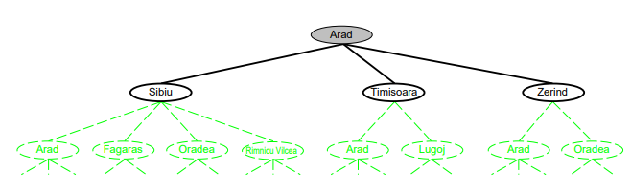
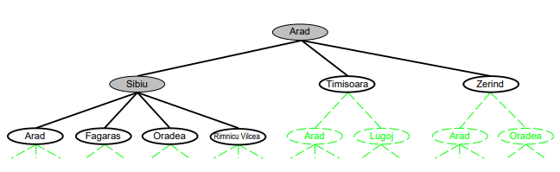
Tree Search Example

Slide 8
Tree Search

Slide 9
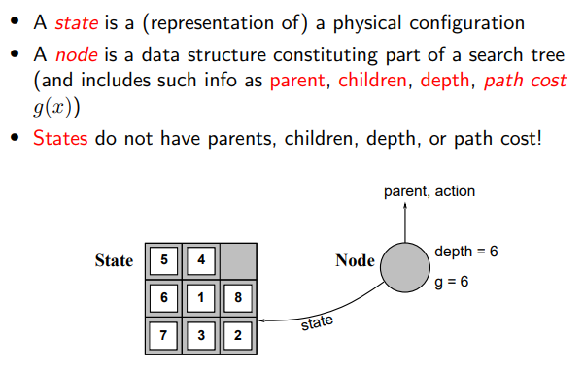
Implementation: states vs. nodes

Slide 10
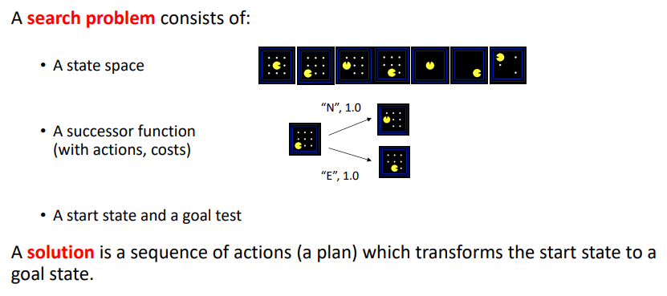
Search Problems

Slide 11
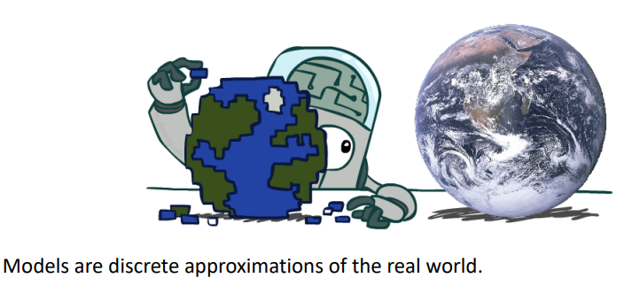
Search Problems are Models

Slide 12
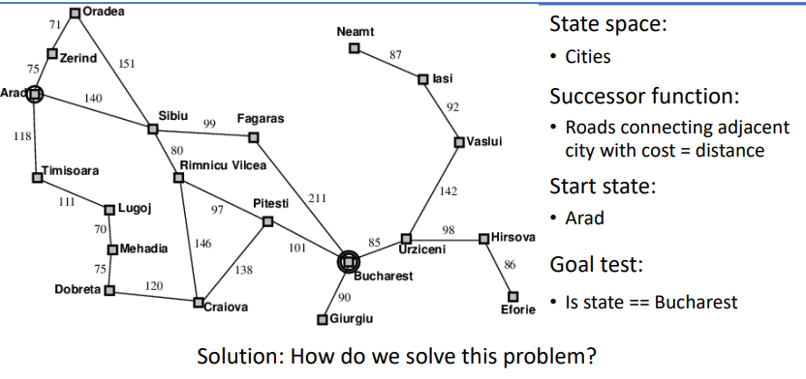
Example: Traveling in Romania

Slide 13
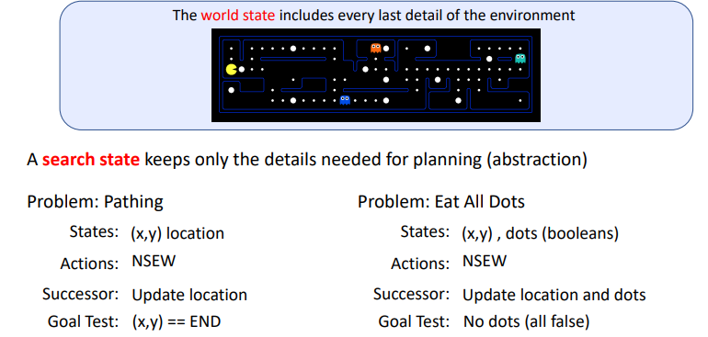
What is a State Space?
The set of all possible configurations of a "system". It is a useful abstraction for reasoning about the behavior of a given system.

Slide 14
State Space Size?
State space represents all possible states of the system and transitions between them.
It represents the behavior of a system.
State space size depends on the problem.

Slide 15
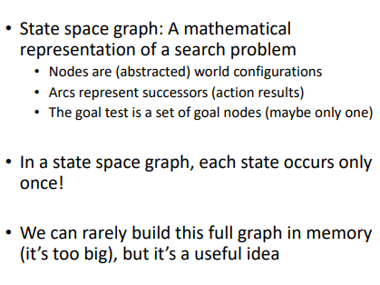
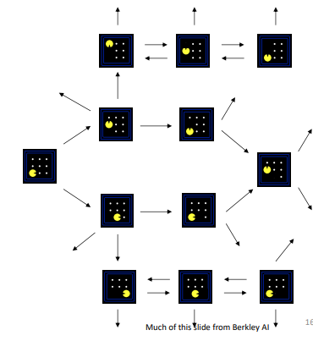
State Space Graph

Slide 16
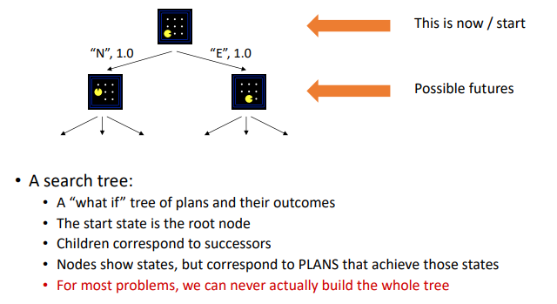
Search Trees

Slide 17
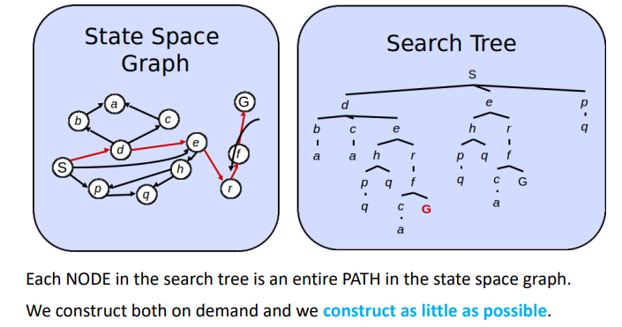
State Space Graph vs. Search Trees

Slide 18
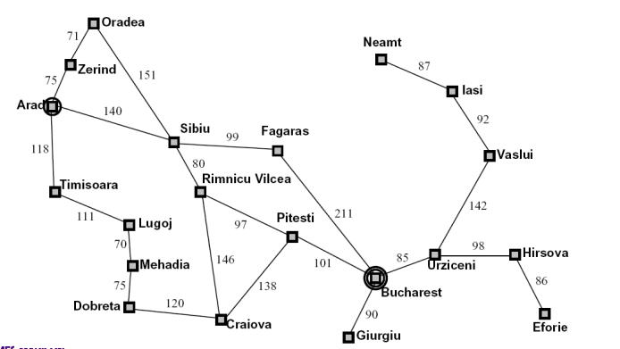
Tree Search: Example with Romania

Slide 19
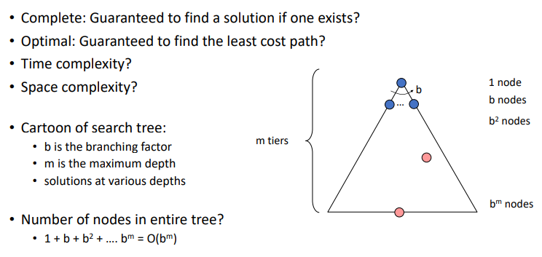
Search Algorithm Properties

Slide 20
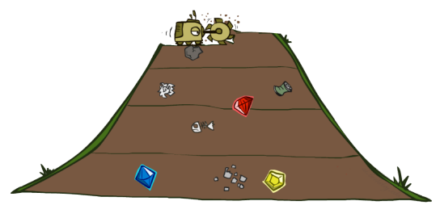
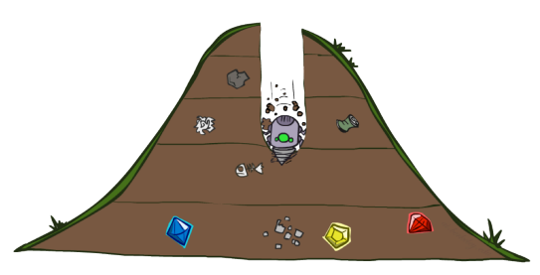
BFS - DFS

Slide 21
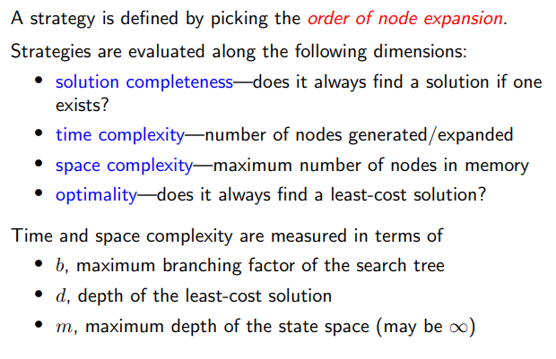
Search Strategies

Slide 22
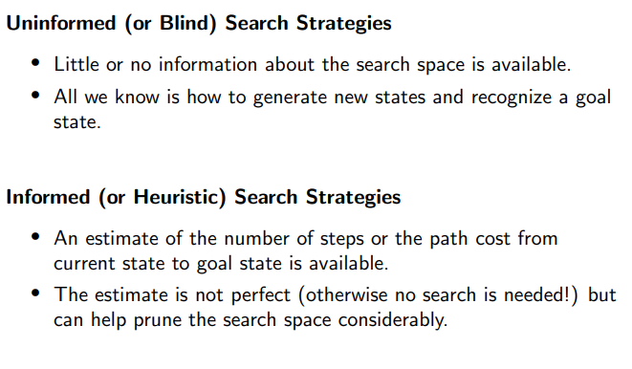
Search Strategies

Slide 23
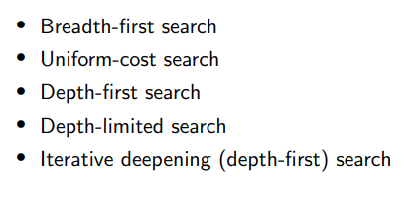
Uninformed Search Strategies
Bidirectional search

Slide 24
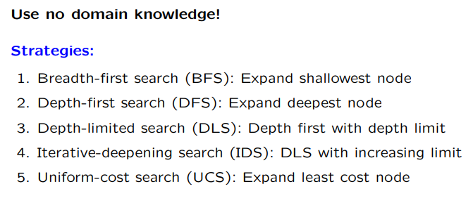
Uninformed search
6. Bidirectional search : Expand from both directions

Slide 25
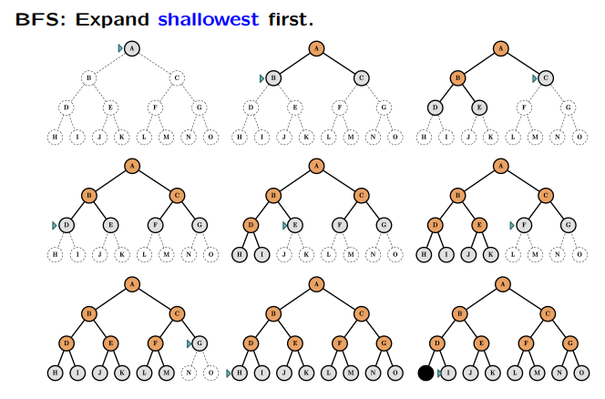
Breadth-first search (BFS)

Slide 26
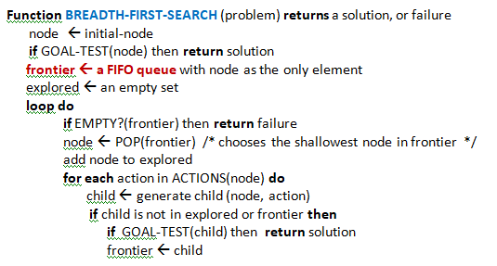
BFS

Slide 27
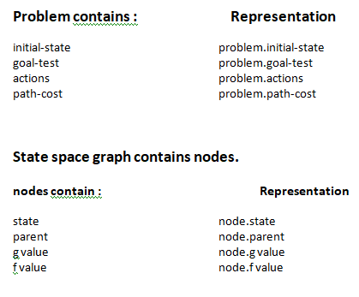
Problem and node

Slide 28
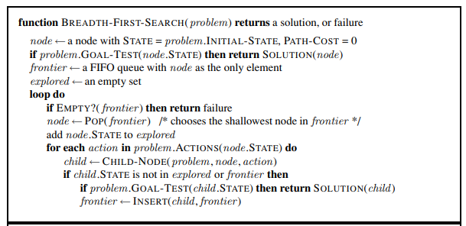

Slide 29
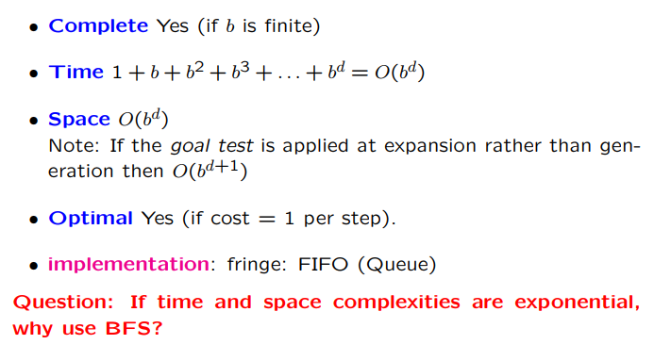
BFS

Slide 30
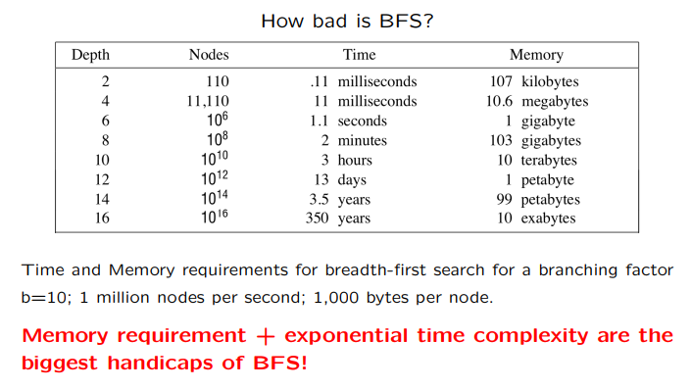
BFS

Slide 31
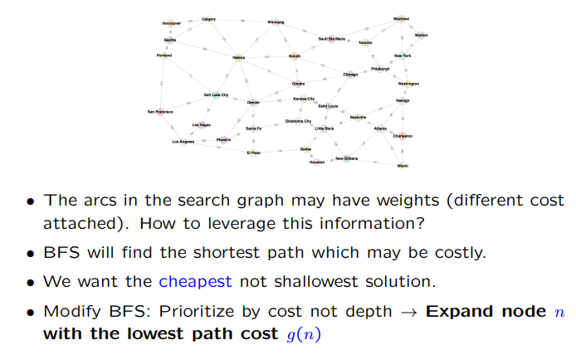
Uniform-cost search

Slide 32
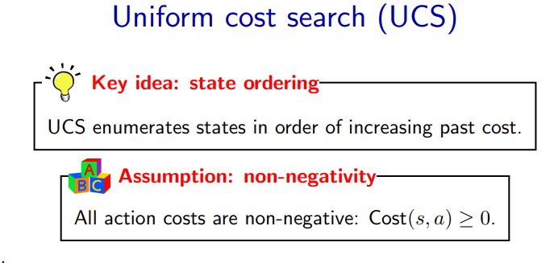

Slide 33
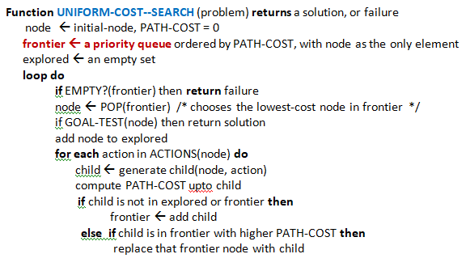
UCS algorithm

Slide 34
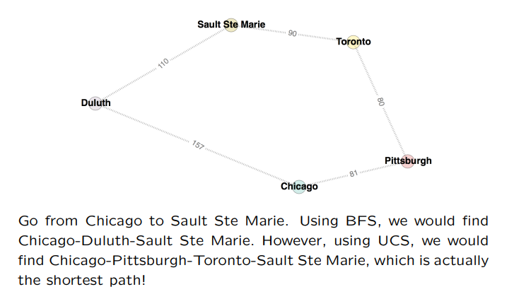
Uniform-cost search

Slide 35
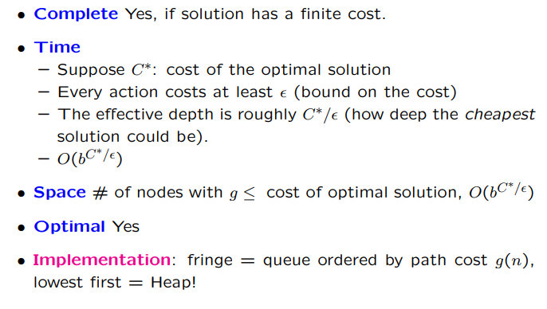
Uniform-cost search
While complete and optimal, UCS explores the space in every direction because no information is provided about the goal!

Slide 36
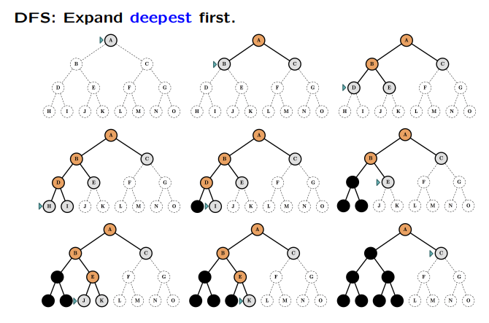
DFS

Slide 37
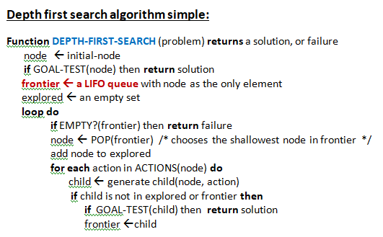
DFS

Slide 38
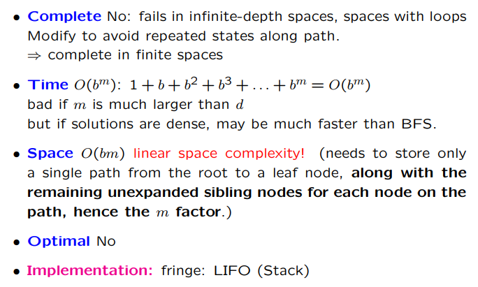
DFS

Slide 39
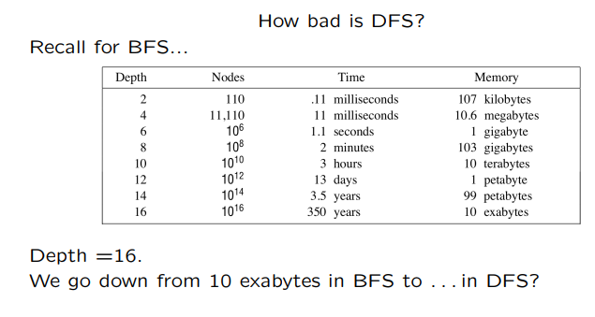

Slide 40
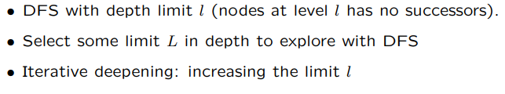
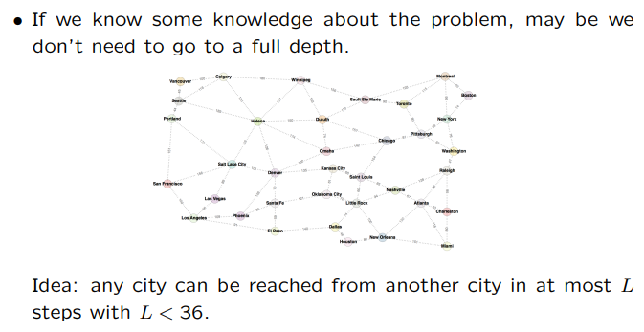
Depth-limited search

Slide 41
Depth-Limited-Search
Depth-first search with a predetermined depth limit l.
Nodes at depth l are treated as if they have no successors.
The depth limit solves the infinite-path problem.
Incompletene when l<d
nonoptimal if we choose l >d.
Depth limits can be based on knowledge of the problem
The diameter of the state space, gives us a better depth limit, which leads to a more efficient depth-limited search.

Slide 42
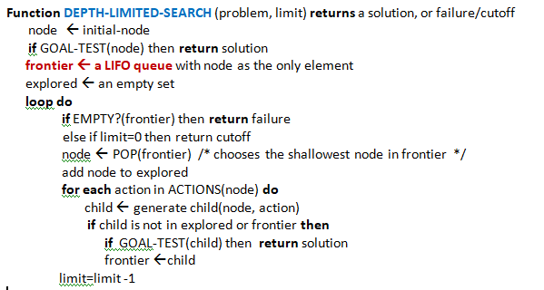
Depth-Limited-Search

Slide 43
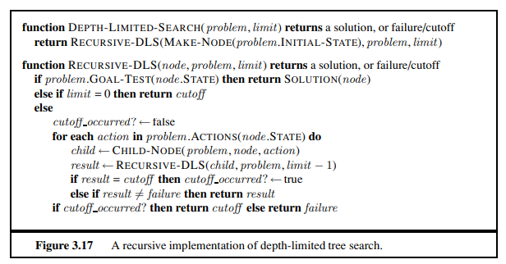
Recursive DLS

Slide 44
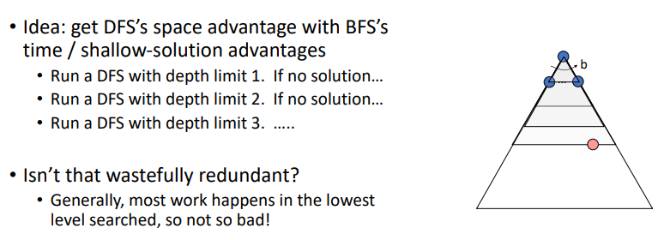
Iterative Deeping Search (IDS)

Slide 45
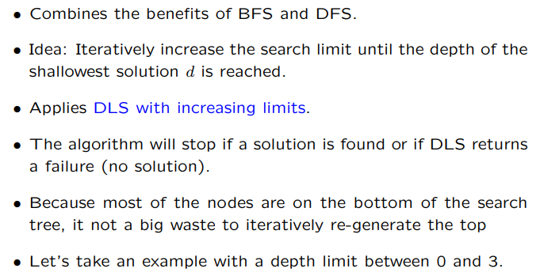
Iterative Deepening

Slide 46
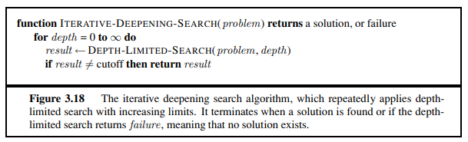
Iterative-Deepening Search

Slide 47
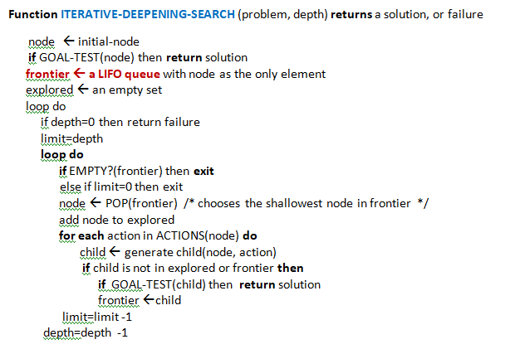
Depth-Iterative Deepening

Slide 48
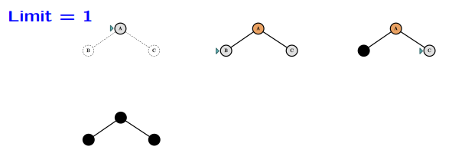
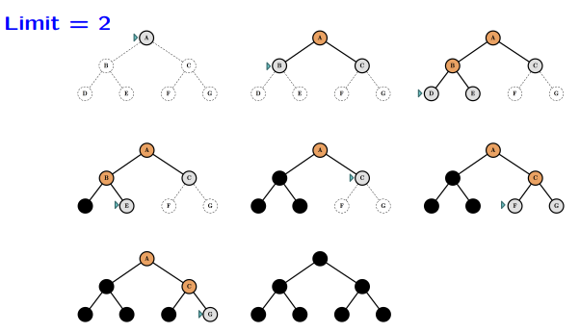
Iterative Deepening

Slide 49

Iterative Deepening

Slide 50

Properties of Iterative Deepening

Slide 51
Bidirectional search
The idea behind bidirectional search is to run two simultaneous searches—one forward from the initial state and the other backward from the goal—hoping that the two searches meet in the middle
Bidirectional search is implemented by replacing the goal test with a check to see whether the frontiers of the two searches intersect; if they do, a solution has been found.
The check can be done when each node is generated or selected for expansion.
The reduction in time complexity makes bidirectional search attractive

Slide 52

Bidirectional search
Even better: search from both the start and the goal, in parallel!
Bidirectional search succeeds when a branch from the start node meets a branch from the goal node.
If the shallowest solution has depth d and branching factor is b on both sides, requires only O(b^{d/2}) nodes to be explored!

Slide 53
Summary

